Slide 1

Tour d’horizon: South African retirement reform
IOPS Technical Committee | Seoul, Korea | National Treasury
Dr David McCarthy | Retirement Policy Specialist
4th November 2013

Slide 2
SA retirement system dominated by funded, quasi-voluntary pillar 2
Pillar 0
  Pension of ~ZAR R 1 500 (USD 150) p.m., means-tested, paid to over-60’s
  Around 2.9m beneficiaries (around 70% of age-eligible population)
  Cost of around 1.5% of GDP, financed from general revenue
Currently no mandatory pillar 1
Pillar 2
  Provision is voluntary for employers, but if employers offer a retirement plan, they can compel employees to join, EET tax treatment
  Workers may supplement their employer-based savings through voluntary individual arrangements, EET tax treatment
  Around 60% of formally employed South African workers participate (~6 million workers)
  Most private-sector workers are in DC funds (although private-sector DB funds still have significant AUM)
  Civil service pensions are funded, in a single DB fund (AUM of ZAR1 200 bn (USD120bn))
  System AUM of ZAR 3 trn (~USD300bn) in 2013

Slide 3
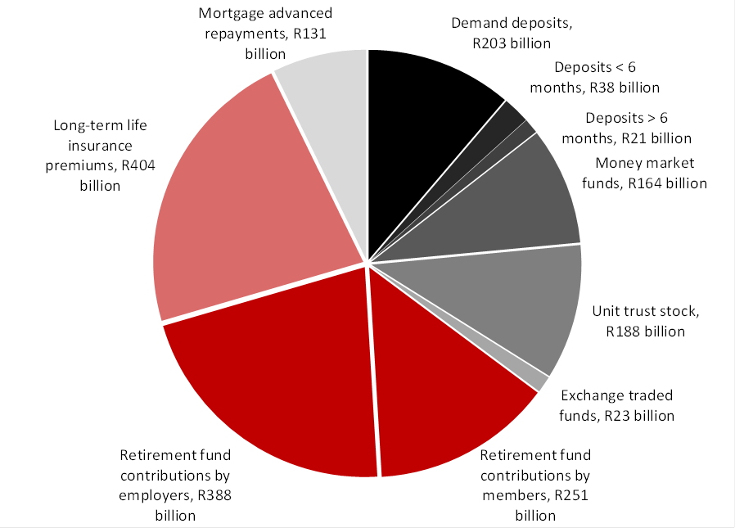
Half of HH savings flow, half of net HH wealth in pillar 2 retirement system
Source: Association for Savings and Investment South Africa, South African Reserve Bank, JSE, figures for total nominal savings flows 1999-2010
Source: South African Reserve Bank, Condensed balance sheet of South African Households, 2010

Slide 4
Overview of 2013 reforms
Short- to medium-term reforms aimed at improving various aspects of the SA system
  Creating a uniform approach to the taxation of retirement funds
  Reforming the annuities market
  Requiring preservation and portability
  Measures to reduce the costs of retirement products
  Introducing tax incentives to promote non-retirement savings
Five policy papers were released over the period 2012-2013 (available at www.treasury.gov.za), series announced in the 2012 Budget speech
  Enabling a better income in retirement (21 Sept 2012)
  Preservation, portability and uniform access to retirement savings (21 Sept 2012)
  Incentivising non-retirement savings (4 Oct 2012)
  Improving tax incentives for retirement savings (4 Oct 2012)
  Charges in South African retirement funds (11 July 2013)
Policy announcements were made in the 2013 Budget speech, more to follow

Slide 5
Tax treatment of retirement contributions and pay-outs harmonised and simplified
Current situation
  5 different bases used to calculate retirement contributions and related tax deductions, making system complex & increasing costs
  “Provident fund” payouts not required to be annuitised
Reforms currently being implemented
  From T-day (1st March 2015), employer contributions to all types of retirement fund will be treated as a fringe benefit in the hands of employees
  Employees will be able to deduct employer and employee contributions up to 27.5% of max(remuneration, taxable income), with a cap of ZAR350 000 (USD 35 000) p.a.
  “Provident fund” post-retirement payouts from post-T-day contributions subject to same annuitisation requirements as “pension funds”
  Currently part of Tax Laws Amendment Bill 2013, before Parliament

Slide 6
Retirement funds to take greater role in providing post-retirement income
  Current situation
    “Provident fund” balances not annuitised on retirement, means test provides further disincentive
    Many retirement fund trustees view their job as complete when individuals retire, leaving individuals to retail market upon retirement
    Intermediary bias toward drawdown products (complex, risky)
  Reforms currently being considered
    Retail Distribution Review examining remuneration of intermediaries to address commission bias (currently underway)
    All retirement funds must develop a default annuity strategy for retiring members, principles-based draft regulations to be released soon (simplicity, suitability, governance)
      Members may opt out of fund-provided default
      Bulk purchasing, implicit fund-provided financial advice
    Remove means test on pillar 0 State Old-Age Grant by 2016
    Make splitting retirement balance between types of annuities easier

Slide 7
Measures to increase the rate of pre-retirement preservation
  Current situation
    Members of occupational schemes may take their entire retirement balance in cash when they change jobs
    Practical default for most funds is to pay members out in cash, almost universal among lower-income, younger workers
  Reforms currently being considered
    Full mandatory preservation viewed as undesirable in a voluntary system (Kenya)
    Phased implementation:
      1: require all funds to develop a default preservation strategy for exiting members, principles-based draft regulations to be released soon (simplicity, suitability, governance)
        Members may opt out of fund-provided default
        Bulk purchasing, implicit fund-provided financial advice
      2: change tax rules to allow regular withdrawals of preserved funds, but of a limited amount, to apply to balance arising from post P-day contributions.

Slide 8
Introducing a TEE-type account for short- to medium-term savings
  Current situation
    “Retirement” funds being used as short-term savings vehicles by many workers
    Changes on preservation rules may deprive these workers of tax-protection for these savings
    SA household savings currently very low, creating BoP problems and possibly constraining investment and hence future economic growth
  Reforms currently being considered
    Introduce a tax-preferred savings account for short- to medium-term savings, TEE tax treatment
    Contributions limited to ZAR 30 000 p.a. (USD 3 000 p.a.), with a lifetime limit
    No restrictions on withdrawal
    Permitted investments must comply with principles on accessibility, simplicity, generality, transparency
    Phased implementation, currently scheduled to commence in 2015

Slide 9
Measures to reduce retirement fund costs are still at draft policy stage
  Current situation
    Parts of the SA retirement system (especially individual arrangements, ‘commercial umbrella funds’) are very expensive by international standards
    Products can be exceptionally complex, especially when intermediated
    Transfer pricing common (‘charge shifting’ from initial costs to recurring costs)
  Reforms currently being considered
    Greater regulation of investment choice, including requiring all funds to develop a default investment strategy for members, principles-based draft regulations to be released soon (simplicity, suitability, governance)
  Draft potential reforms still being discussed
    Improving governance, consolidating funds, increasing standardisation of fund rules and contracts
    Simplifying products by standardising permitted charging structures
    Requiring greater disclosure of charges (incl . special treatment of derivatives)
    Moving towards mandatory savings, by creating a retirement fund exchange, to facilitate contributions by small businesses, possible contribution subsidy, strict rules for listing

Slide 10
THANK YOU

