Slide 1
APRA SOARS model - supervisory strategies for APRA regulated institutions
Ross Jones
Deputy Chairman, Australian Prudential Regulation Authority
President of International Organisation of Pension Supervisors (IOPS)
Lima, Peru
8 September 2011

Slide 2
Outline
Introduction
Quick revisit to APRA supervisory process and PAIRS/SOARS
What do the SOARS categories mean?
Where do they fit on the ‘enforcement pyramid’ model?
After the rating – action
  Supervisory action plans – examples
  Enforcement action - examples

Slide 3
Supervision process - APRA
Supervision Activities
Prudential consultation
Prudential reviews
Targeted reviews
Ad hoc meetings
Supervision Strategy
Supervisory action plans
Risk Assessment
Offsite analysis
PAIRS Update

Slide 4
Outcome of PAIRS Process = SOARS

Slide 5
Normal
Risk profile | not expected to fail in any normally foreseeable circumstance robust governance, management and control processes strong capital position, absorb unexpected losses
APRA concerns | Low (but always watching!)
Supervision activities | On going collection and analysis of data supported by routine prudential reviews on a cyclical basis.

Slide 6
Oversight
Risk profile | not expected to fail in any normally foreseeable circumstance robust governance, management and control processes strong capital position, absorb unexpected losses
APRA concerns | entities recognise weaknesses and work to overcome them entities with naturally high level of inherent risk understand limited scope to assume more risk
Supervision activities | Significant increase in supervision intensity however entity is not considered likely to fail. More frequent information and visits. Board and senior management given strong signals of concern. Either transitional (must improve back to Normal) or ongoing classification (because of inherent risk)

Slide 7
Mandated improvement
Risk profile | unlikely to fail in short term BUT potential for manner of conduct of operations to put beneficiaries at risk
APRA concerns | turnaround occurs before entity is forced into restructure
Supervision activities | Entity produces and executes a remediation plan. Transitional classification. Either improve or exit the industry.

Slide 8
Restructure
Risk profile | entity unable to rectify serious identified weaknesses no confidence that financial promise to beneficiaries can be met without vigorous intervention may no longer be viable, or in run-off mode
APRA concerns | to minimise risk of loss, or if failure is unavoidable, to minimse the size of the loss
Supervision activities | entities have failed or are about to fail. Full use of supervisory and legislative powers to protect beneficiaries. For example, withdraw licence, replace trustee entities are overseen by APRA’s Enforcement Unit

Slide 9
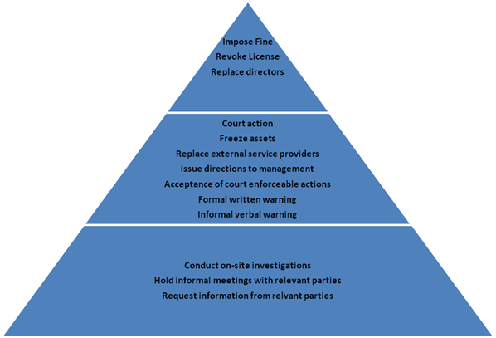
Escalation
APRA’s restructure
APRA’s mandated
improvement
APRA’s oversight

Slide 10
Supervisory Action Plans
Supervisory action plans set out how we are going to implement the supervisory stance
Supervision activities will be formalised using supervisory action plans
PAIRS and supervisory action plans are dynamic
Assessments should reflect an entity’s current position and the risks/issues it faces
Supervisory action plans established on a rolling basis
Reviewed at least every 12 months

Slide 11
Supervisory action plans may include some of these risk-based activities..........
Risk-based prudential reviews (i.e. operational risk, credit risk, market and investment risk, insurance risk)
Technical meetings with entity or internally within APRA
Monitoring of capital, liquidity, solvency position (for defined benefit funds)
Discussions/meetings with Senior Management (CEO, CRO, CFO, Appointed Actuary, Audit)
Monitoring of investment conditions
Reviewing specific plans or reports
Baseline activities may also be used to address risks (i.e. prudential consultations/prudential reviews)

Slide 12
Example – fund 1 – supervisory action plan
DB with DC section
Fund in financial services corporate group
Employer financial position – still profitable but weakened by GFC
DB solvency risk?
Revise investment strategy?
Facing drop in new members/contributions due to competition
Revising strategic plan to retain and attract new members
Strategic/business risk?
Normal category, but..........

Slide 13
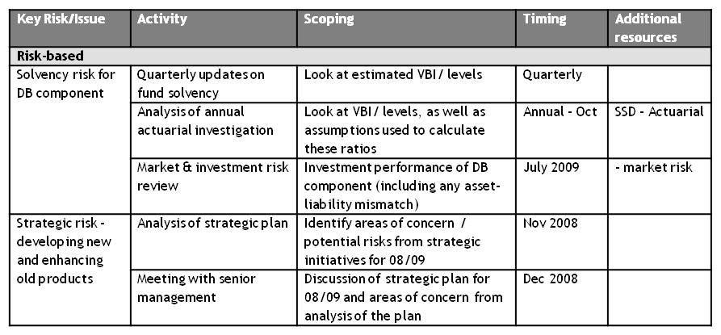
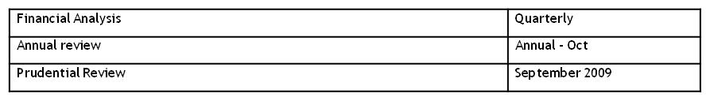
Supervisory Action Plan – Example (1)

Slide 14
Example – fund 2 – supervisory action plan
DC fund
Involved in merger
Operational risk - IT systems not reliable
Investments – assets concentrated in property and equities
Liquidity risk – particularly with merger
Revising strategic plan to retain and attract new members
Strategic/business risk?
Oversight category, increase the supervision

Slide 15
Supervisory Action Plan – Example (2)
Key Risk/Issue | Activity | Scoping | Timing | Additional resources
Risk-based
Management | Review and monitor entity action plan | Discussion of progress of entity action plan against targets | Quarterly
Balance Sheet and Market risk | Quarterly updates on asset allocation | Look at portfolio concentration | Quarterly | BS & MR
Liquidity risk | Analysis of cash flows | Investment strategy – new contributions to liquid assets | Quarterly
Operational risk | IT risk review | IT systems and controls, compatibility with systems of merging fund | Next quarter | - IT risk
Board | Prudential consultation | Meeting to review progress in risk mitigation | In 6 months
Baseline
Financial Analysis |  |  | Quarterly
Annual review |  |  | Annual – Oct
Prudential Review |  |  | September 2011

Slide 16
Examples of Restructure (1)
Background
  Trustee of 4 funds, also operated other investment entities
  Breached licence conditions
  Failure to satisfy APRA of valuations of fund assets
APRA action
  Issued direction to freeze assets
  Suspended ‘portability’ obligation (to prevent run on fund)
  Suspended trustee, appointed replacement trustee
  Formally removed trustee
  Former trustee placed in external administration
  Investigation to recover funds
  Working with market conduct/disclosure regulator
Further enforcement options open to APRA
  Disqualification of former directors/managers etc

Slide 17
Examples of Restructure (2)
  Background
    Trustee of 1 fund
    Enforcement action taken previously over related party service provider
    3 trustee directors disqualified
    Subsequent issue - victimisation by a director of 2 remaining directors
  APRA action
    Identified breach of legislation that prohibits victimisation of trustees
    Laid charges
    Person to stand trial for alleged victimisation

Slide 18
Thank You
Questions?

