Slide 1
Session II: Risk Identification and Focus and Risk Indicators
Risk Identification in practice
Thursday 8th September, 2011, Lima - Peru
Comisión Nacional del Sistema de Ahorro para el Retiro
Notes:
11:00-12:30
Session II: Risk Identification and Focus and Risk Indicators
11:00-11:45
Speakers:
IOPS Toolkit Modules 2+3 – Taliya Cikoja, IOPS Secretariat
Risk Identification in practice – David Plascencia Perdomo, CONSAR Mexico
Risk Identification in practice– Renato Hamel, Superintendent Pensions, Chile

Slide 2




CONSAR has different methods and processes for identifying risks within a pension fund
PENSION FUNDS (AFORES) Internal Architecture
- Corporate governance defined in regulation must operate efficiently and fulfill the responsibilities entrusted to it.
Shareholders
Board of Directors
Independent Board member
C.E.O.
Compliance Officer
(ensuring observance of all the regulations)
- The manuals describe prudential measures, internal processes, best execution practices, etc.
Prospectus
Risk Management Commitee
Investment Commitee
- A prestigious independent expert must evaluate once a year, processes and models of the Specialized Risk Management Unit
Self- correction programs
monthly Reports
Independent Counselor.
Independent Counselor.
Minutes of committee
Independent Expert.
Operation Dept
- The Compliance Officer, through “Self- correction programs” reported failures of regulation and is responsible for following up.
With this AFORES achieves a 75% discount on the amount of sanction.
Investments Unit
Independent and central risk management Unit
Accounting Dept
Legal Dept
Comercial Dept
Investment management procedure manual.
Risk management procedure manual
Comercial Dept
Back Office
2

Slide 3
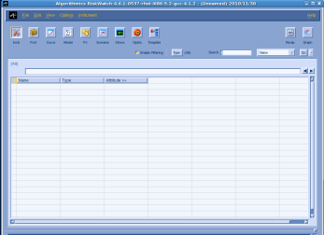
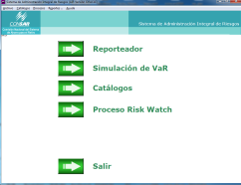

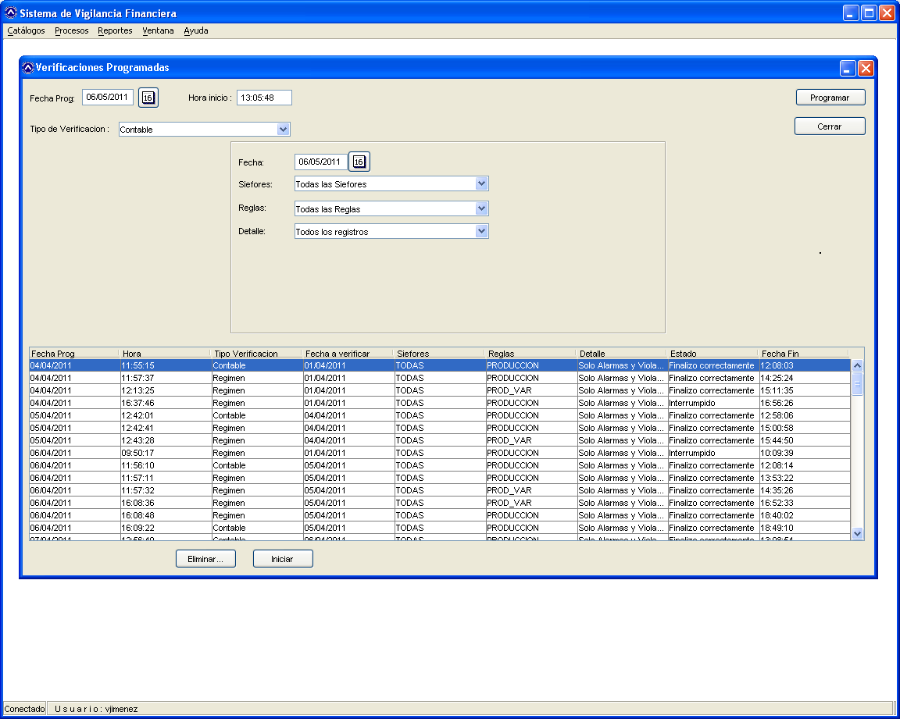
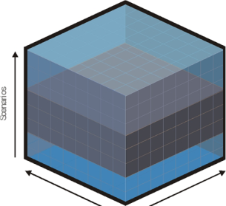

Supervision Process runs on daily basis.
SUPERVISION PROCESS
AFORES
CONSAR
(DATABASE)
In due time and proper form
Preserved without modification for legal support.
INDEVAL
LOCAL CUSTODY
INTERNATIONAL CUSTODY
Transmits information
(INSPECTION)
Sell/ Buy activity
On daly basis
(Before 18hrs)
Siefores’ asset holdings.
Accounting (Financial Statement, Cash flows, balance sheets.
VaR Scenarios
- Regulatory non compliance
- Advices.
Sanctions
Riskwatch System
http://www.consar.gob.mx/normatividad/pdf/normatividad_emitida/circulares/Compilacion_19-8_19-9_19-10_y_19-11.pdf
Derivative holdings.
RiskWatch
Note decompositions
Risk Factors
Prices
Characteristics of instruments
Risk Analysis System
PRICE VENDORS.
VALUATION AGENTS.
INFORMATION SYSTEMS.
Analysis and Reporting
Surveillance System
SUPERVISION
(DATABASE)
Workflow System

Slide 4
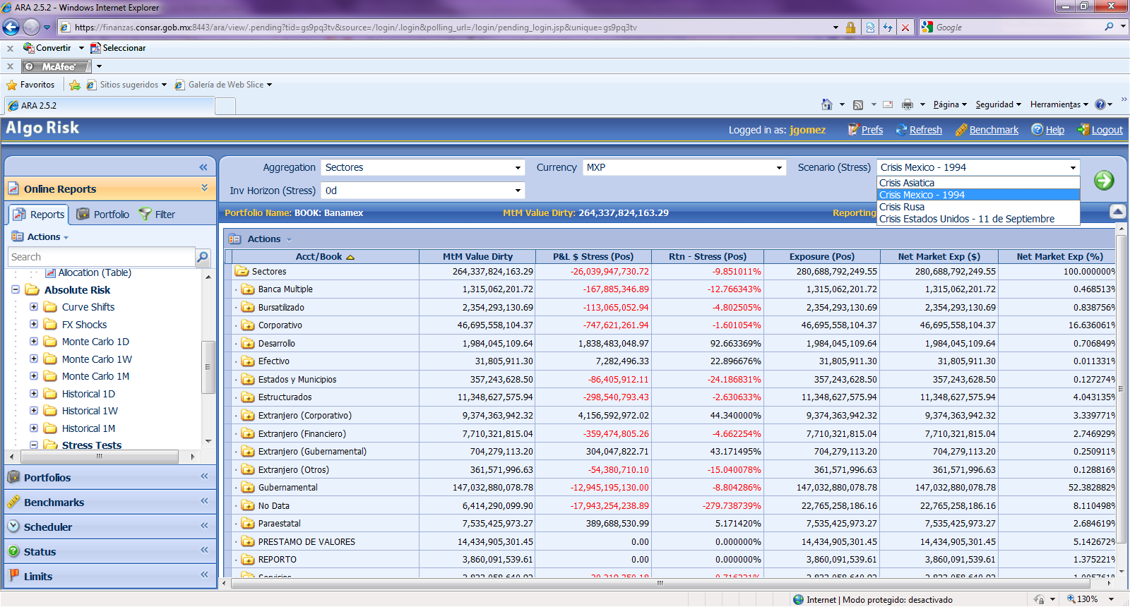
Riskwatch System
-Stress Tests
-What if analysis
-Credit Risk
-Curve Shift
-FX Shocks
-Liquidity Risk
-Monte Carlo VaR
-Historical VaR
- VaR Contribution

Slide 5

Example
Mexico's economic crisis of 1994 was the last and most recent crisis in the country of global implications.
TEQUILA EFFECT BASE INDEX (100% = Tequila effect)
X = 100%
100%
94%
90%
80%
70%
60%
50%
40%
30%
29%
21%
19%
20%
13%
12%
10%
2%
0%
Russian
Crisis
1998
Máximo
Asian
Crisis
1997
+100 PBS
5% inflation
-
-
Mexican Crisis
1994
5% MXPUSD
Drawdown
September 11
2001
(22
-
oct
-
2008)
In the period from 15 to 30 December 1994 the rate Cetes 28 days rose from 13.75% to 31%, the exchange rate peso-dollar exchange rose from 3.4606 to 4.995 and later reach levels per dollar of 7.2 and stabilized at 6 pesos on average
Notes:
Crisis Rusia 1998
La devaluacion del rublo, el 17 de agosto de 1998, marco el fin de la estabilidad rusa y la necesidad de un nuevo programa de estabilizacion, como la necesidad de incrementar la recaudacion fiscal por parte del Estado Ruso. El descenso de los precios del petroleo en los meses previos ayudo a debilitar a la moneda, acelero la incertidumbre, el riesgo pais e incremento la fuga de capitales en cerca de 4 000 millones de dolares solo unas semanas previas a la declaracion de la moratoria por parte de Rusia.
El tipo de cambio en Mexico en el periodo del 17 de agosto al 17 de septiembre de 1998 vario de 9.3018 a 10.3158 , la tasa de Cetes a 28 dias subio de 21.49% a 47.86%, el IPC bajo de 3533.14 a 3395.98.
Crisis Mexico 1994 (Crisis Tequila)
La crisis economica de Mexico de 1994 fue la ultima y mas reciente crisis del pais de repercusiones mundiales. Fue provocada por la falta de reservas internacionales, causando la devaluacion del Peso durante los primeros dias de la presidencia de Ernesto Zedillo.
En el periodo del 15 al 30 de diciembre de 1994 la tasa de Cetes a 28 dias subio del 13.75% al 31%, la cotizacion del tipo de cambio Peso-Dolar subio de 3.4606 a 4.995.
Sin poder mantener la nueva banda de la tasa de cambio, a principios de 1995, la administracion de Zedillo decidio establecer el sistema de libre flotacion del peso, el cual va llegar a 7.2 pesos por dolar.El dolar se estabilizo a un precio de 6 pesos en promedio, antes de ser afectado por la Crisis Asiatica de 1997.
Crisis Asia 1997
La crisis financiera de Asia Oriental, estallo con la devaluacion del BAHT Tailandes el 2 de Julio de 1997, el cual arrastro a las monedas de Corea del Sur, Malasia, Filipinas e Indonesia.
Los efectos de la crisis del Asia se transmiten a America Latina por canales comerciales y financieros, afectan de forma disimil a distintos paises, y motivan medidas de politica en las areas monetaria, financiera y comercial.
En el periodo del 15 de octubre al 5 de noviembre de 1997 el tipo de cambio peso dolar se ubico de 7.7336 a 8.1659 pesos por dolar, la tasa de Cetes a 91 dias aumento de 19.12% a 24.4%, el IPC bajo de 5341.76 a 4823.68.
El contagio importante a Mexico de los paises de Asia se materializo solo despues de los eventos del cuarto trimestre de 1997, probablemente como reflejo de cambios drasticos en la percepcion sobre las perspectivas de las economias de los mercados emergentes.
11 de Septiembre 2001
Si bien el 11 de septiembre no es una crisis financiera, es importante analizar los efectos en el entorno financiero y poder predecir el impacto que un evento similar produciria.
Por esta razon se analizan las variaciones que tuvieron las tasas de interes,tipos de cambio asi como en los distintos factores de riesgo que influyen en el valor de las carteras de las Siefores entre el 10 y el 17 de septiembre de 2001.
A partir del 11 de septiembre los mercados de Estados Unidos permanecieron cerraron, volviendo a abrir el 17 de septiembre, con un descenso del 5% en el S&P 500; ademas, en Europa, el DAX bajo 9% y el Euro aumento de 0.90 a 0.92 dolares. En Japon, el Nikkey 225 bajo 7% mientras el yen cotizo de 121 a 118 yenes por dolar.

Slide 6
Example
Another complementary tool is the value at risk contribution
Contribution to Value at Risk (Base 100 by type of Siefore)

Slide 7
Example
The marginal VaR for derivatives represents the amount of risk that derivatives will add to the portfolio
( A ) – ( B )
=
(Total VaR)
( A )
( A )
Derivatives
-
(VaR without derivatives)
( B )
If (B) is greater than (A) means that derivatives help reduce the risk.

Slide 8
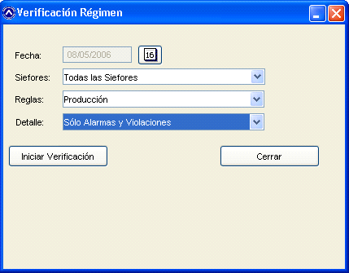
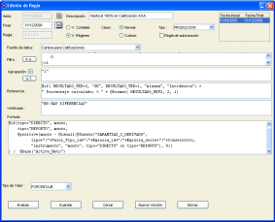
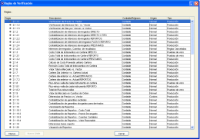
Surveillance System
Verifies Investment Regime fulfillment, valuation and accounting records.
To validate more than 2,000 instruments in 187 funds takes approximately two hours
R
gimen de
Investment Regime
Inversi
n
Contabilidad
Financial accounting validations

Slide 9
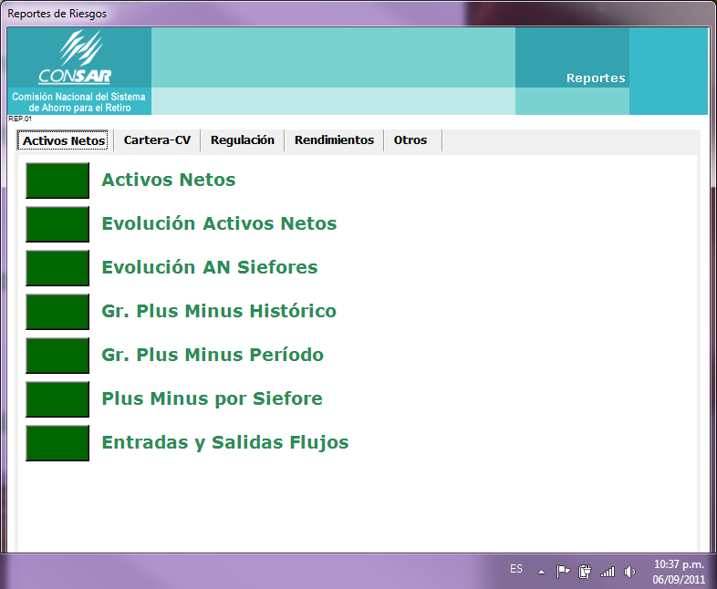
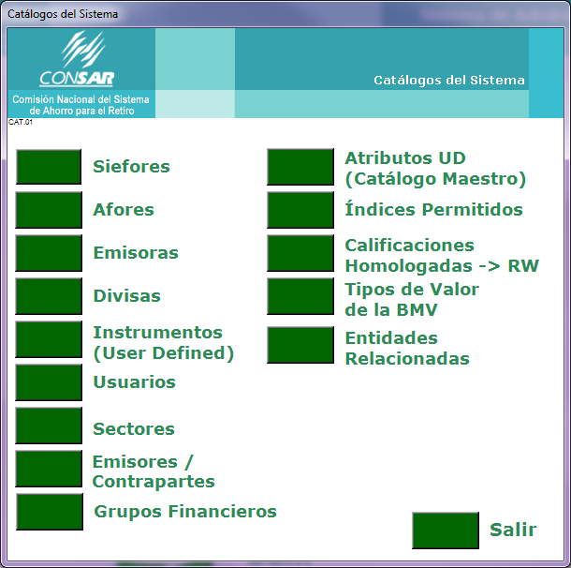
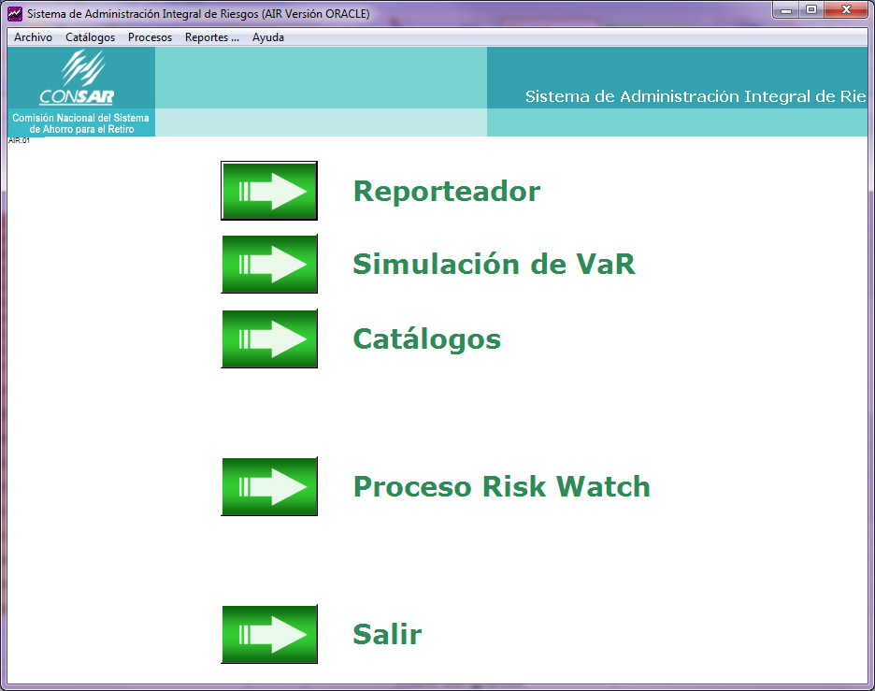
Risk Analysis System
Performance Contribution
Daily gains and losses
Asset Allocation Reports
Historical Analysis
Diversification Reports
Relevant Trades (outliers)
Inflows and Outflows.
Risk Measures (WAM, Durations, Maximum Drawdown
, etc)
Liquidity Reports
Credit Reports
Sectorial Reports
Net Return Indexes
Etc.
R
gimen de
Inversi
n
Contabilidad

Slide 10


Inspections (Prudential reviews on-site)
2. Corporate Governance
3. Compliance Officer
R
gimen de
Inversi
n
4. Back Office and Treasury
1. Investments Unit
Contabilidad
5. Independent and central risk management Unit
Inspector focuses on problems or vulnerabilities of each AFORE.
Risk Identification
Actions to reduce risk
Analysis &
Risk Scoring Update

Slide 11
Inspections (Prudential reviews on-site)
The topics reviewed and the depth of the in-situ inspection vary in each case depending on
  The profile of the Afore
  The size and complexity of its operations
  Previous problems or weaknesses identified
  Qualifications of its operators
  Failures detected through the daily surveillance of portfolios.
If a weakness is identified and a recommendation is emitted and depending on the seriousness of the breach
  Functionaries and/or operators may be removed
  Investment authorizations in specific instruments may be revoked Even the license to operate may be revoked.
  Legal action may be taken

Slide 12

CONSAR has different methods and processes for identifying risks within a pension fund
-Compliance Officer Monthly Reports
-Inspections
-Independent Expert Reviews
-Self-correction programs
-Surveillance
System
-Quantitative Risk Analysis
-Internal Reports and meetings
-Questionnaires to the Afores
…Others

Slide 13
Session II: Risk Identification and Focus and Risk Indicators
Risk Identification in practice
Thursday 8th September, 2011, Lima - Peru
Comisión Nacional del Sistema de Ahorro para el Retiro
Notes:
11:00-12:30
Session II: Risk Identification and Focus and Risk Indicators
11:00-11:45
Speakers:
IOPS Toolkit Modules 2+3 – Taliya Cikoja, IOPS Secretariat
Risk Identification in practice – David Plascencia Perdomo, CONSAR Mexico
Risk Identification in practice– Renato Hamel, Superintendent Pensions, Chile

