Slide 1
Session I: Introduction to and Preparation for Risk-based Supervision
Challenges to introducing RBS
Thursday 8th September, 2011, Lima - Peru
Comisión Nacional del Sistema de Ahorro para el Retiro
Notes:
National Commission for the Retirement Savings System (CONSAR)
Session I: Introduction to and Preparation for Risk-based Supervision
9:15-10:00
Speakers
Introduction to the IOPS Toolkit + Module 1 – Ross Jones, President of IOPS
Challenges to introducing RBS – David Plascencia Perdomo, CONSAR Mexico
Challenges to introducing RBS – Renato Hamel, Superintendent Pensions, Chile
----------
This workshop will be held at the Miraflores Park Hotel, Av. Malecón de la Reserva 1035, Miraflores, Lima, Peru.
The IOPS has obtained the negotiated rates for participants of the workshop at the Miraflores Park Hotelhotel:
---------
Paseo de la Reforma No. 2601 Col. Lomas de Chapultepec, México, D.F.
Tel.: +52 (55) 1105-2270 Email: embaperu@prodigy.net.mx
Horario de atención: Lunes a Viernes de 9 a 17 hrs.
-----------------

Slide 2
The pension reform of 1997 in Mexico introduced for the first time a fully-funded defined-contribution pension system based on private accounts.
  Accounts managed by Afores have grown from 11 millions in 1997 to slightly above of 42 millions as of August of 2011, for private and public sector employees.
2

Slide 3

Pension Funds’ assets under management (AUM) amount to more than US $122.65 billion as of August 2011. These assets provide funding mainly to Mexico’s public and private entities.
Mexican Pension Funds’ assets under management
CONSAR – FINANCIAL VICEPRESIDENCY
Figures in US million. Currency exchange constant. Data as of August 2011. Source: CONSAR.
Pension Funds’ assets under management represent 11.2% of the GDP
3

Slide 4
The rapid accumulation of resources has influenced the evolution of the investment regime and the design of the family of funds
Structural changes of the Investment Regime
1
2002
3
2009
5
2011
Individual Stocks Investment
Also allows investment in IPO's with the aim of supporting small caps companies.
Investment Mandates, Commodities, more eligible countries and FX
More diversification
Investment in Private Debt
Mainly Mexican companies.
INVESTMENT REGIME EVOLUTION
1997
2
2005
4
2009 - 2010
Investment in Government Securities and Banking
Equity Investment
Most of the resources are allocated to Mexican companies.
Structured Securities
PE / REITS
Support small and medium enterprises and infrastructure projects through the CKD's
  The flexibilization of the investment regime is a precondition to foster the diversification of the portfolios and is thus a necessary element for having sustainable higher returns, but this also complicates the supervision process
4
Notes:
Vicepresidencia Financiera -CONSAR

Slide 5
On the other hand, the family of funds allows the specialization of long term investment strategies that are suitable to different risk profiles.
Returns
Basic Fund 5
SIEFORES
(Pension Funds)
Basic Fund 5
(27 a 36 )
3 years 10.32%
Basic Fund 4
NET RETURNS (36Mths)
(37 a 45)
Basic Fund 4
Basic Fund 3
3 years 9.90%
(less than 26 years old)
(46 a 59 )
Basic Fund 3
Basic Fund 2
3 years 9.37%
(60 years and +)
Basic Fund 2
Basic Fund 1
3 years 8.67%
Basic Fund 1
Structured Assets
Equities
3 years 8.52%
Foreign Debt Securities
Fixed Income Securities
VaR Limmit
0.7%
1.1%
1.4%
2.1%
2.1%
Assets Under Management* | 12,108 | 29,745 | 37,175 | 34,462 | 7,933
TOTAL AUM
122,647
Historic Pension Funds’ Returns: 13.35%, NET RETURN (36Mths) = 9.32%
* Figures in US$ Million. Data as of August 2011. Figures including PensionISSSTE. Total AUM includes Suplementary Siefores and PensionISSSTE Afore.
Notes:
Vicepresidencia Financiera -CONSAR

Slide 6
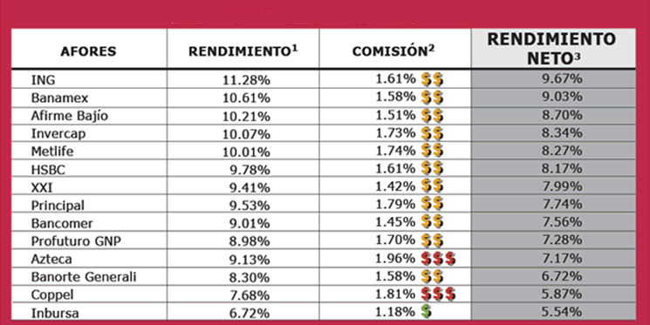
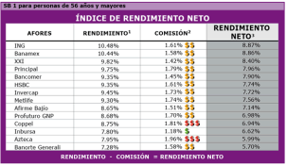
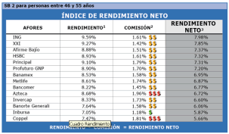
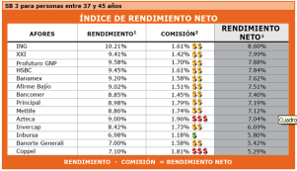
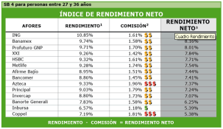
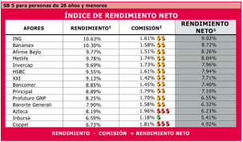
The efficiency of the system also hinges on the driver of competition among AFORES which is based on Returns Net of Fees (introduced in April of 2008.)
  Industry driver of competition
Net Return = Nominal Return – Fee
Allow switches of workers from a pension funds with lower net return to another with higher net return.
NET RETURN INDEX
RETURN
FEE
NET RETURN
B1
B2
B3
(60 years and +)
B4
(46 a 59 )
B5
(37 a 45)
(27 a 36 )
(less than 26 years old)
The information corresponds to SB5 as of July 2011.
AFOREs have to strive for higher returns and lower fees as a result of the rules of the game.
6
Notes:
Vicepresidencia Financiera -CONSAR

Slide 7





In the Mexican pension fund system, there are 14 fund administrators (AFORES), these Administrators have a Corporate Governance and procedures for smooth operation.
PENSION FUNDS (AFORES) Internal Risk Management Architecture
AFIRME BAJIO
Shareholders
1
(5)
(5)
2
AZTECA
Board of Directors
Independent Board member
(10)
3
BANORTE
(7)
C.E.O.
Compliance Officer
(ensuring observance of all the regulations)
4
BANAMEX
5
BBVA BANCOMER
Prospectus
(11)
6
PROFUTURO
(7)
COPEL
Risk Management Commitee
7
(5)
Investment Commitee
8
INBURSA
Self- correction programs
monthly Reports
(5)
ING
Independent Counselor.
9
(6)
Independent Counselor.
INVERCAP
10
(5)
Minutes of committee
Independent Expert.
11
METLIFE
(6)
Operation Dept
12
(5)
PRINCIPAL
Accounting Dept
13
XXI
Investments Unit
Independent and central risk management Unit
(5)
Legal Dept
14
PENSIONISSSTE
(5)
Investment procedure manual
Risk management procedure manual
Comercial Dept
87 SIEFORES
(Pension Funds)
Back Office
7
Notes:
Risk management strategy
Board committes
RM functions
Internal controls
Responsabilities
Dealing with operational and financial risk

Slide 8
With regard to the risk based principles, the supervision is divided into two main areas: the operational activities and the investment of the resources.
Comisión Nacional del Sistema de Ahorro para el Retiro (CONSAR)
ORGANIZATION CHART
CHAIRMAN
LEGAL VICEPRESIDENT
OPERATIONS VICEPRESIDENT
FINANCIAL VICEPRESIDENT
HEAD COORDINATOR OF INFORMATION AND LIAISON
HEAD OF COMMUNICATION DISTRIBUTION AND INSTITUCIONAL LIAISON
HEAD OF FINANCIAL SUPERVISION
HEAD OF FINANCIAL PLANNING AND ECONOMIC STUDIES
HEAD OF THE INTERNAL INSPECTORATE ORGANISM
HEAD OF ADMINISTRATION
MANAGER OF FINANCIAL SURVEILLANCE AND INSPECTION
MANAGER OF RISK ANALISIS AND EVALUATION
CONSAR has 220 employees distributed in the following divisions.
8

Slide 9
CONSAR is in charge of the coordination, regulation, supervision and oversight of the DC retirement savings systems (SAR). The Financial Supervision acctivities are segmentades as folows:
General Direction of Financial Supervision’s Organic Structure.
Financial Vicepresidency
Head of Financial Supervision
Manager of Surveillance and Inspection.
Assistant Manager of Inspection
1
3
Assistant Manager of Sourviliance
1
3
4
5
6
Manager of Risk Management.
Assistant Manager of Risk Management
1
2
3
4
5
6
7
2
2
4
Assistant
I T
Supervision made in
Automatized daily basis
FINANCIAL
AFORE’s facilities.
Supervision made at
SURVEILLANCE
CONSAR.
INSPECTION
FINANCIAL
SUPERVISIÓN
FINANCIERA
RISK MANAGEMENT
Daily basis Supervision
of Siefores’ Financial Risks.
… CONSAR has full operational independence in the exercise of its responsibilities and powers, in particular with regard to supervisory acts, including the use of enforcement and imposing sanctions to Afores.
Total = 26

Slide 10

The Mexican regulator and supervisor seeks to mitigate the greatest potential risk to the pension system…
FACTORS MOTIVATING THE ADOPTION OF RISK-BASED SUPERVISION
Mexican Case
1
The search for efficiency profit and adequate infrastructure to operate.
2
To take advantage of the increasing sophistication and complexity of Investment Regime and markets, with rules designed to strengthen risk management and self imposed proper internal controls.
3
It is no longer feasible to monitor all of the
operations of financial institution.
4
The need to allocate scarce supervisory resources efficiently.
The reorganization conducted to a type of supervision that requires more specialized skills in order to see beyond the regulation
10
Notes:
10
10
10

Slide 11
Sequence of events that triggered the incorporation of Risk Based Supervision (RBS) elements.
Timeline
2010
Reworking in VaR methodology in order to solve negative pro-cyclical phenomenon observed during the crisis.
Nov. 2002
Introduction of Value at Risk (VaR) as a regulatory limit.
Oct. 2005
Specifications about losses due to Administrators.
2001
Derivatives and Securities lending
2008
Multi-Funds
INVESTMENT REGIME
1998
Beginning of Pension Fund System. Investments where made mainly in governmental assets.
Jan. 2005
Investment Regime opening, allowing foreign assets holdings and international equities investments.
2005
Cross-section in two Basic Funds per Administrator.
2007 – 2009
Investment Regime opening doing possible to Invest in Alternative Assets.
2010-2011
Investment Regime opening, allowing investment mandates, commodities, increasing eligible countries and currencies.
Number of Pension Funds.
14
20
52
65
64
109
101
89
87
1998
2002
2005
2006
2007
2008
2009
2010
2011*
* Data as of September 6th, 2011.

Slide 12
Sequence of events that the supervisory authority undertook in moving towards RBS.
CONSAR’s Supervision Model keep elements of traditional Supervision where risk controls and corporate governance are legally laid down.
Furthermore, there are Risk Based Supervision elements that have been adopted ,which allow us score each AFORE and identify vulnerabilities within Pension Fund System.
Regulator Steps that were solve.
RISK IDENTIFICATION
- Depends on specialization of each collaborator.
RISK QUANTIFICATION
- When settle different grade of impact and occurrence probabilities, is necessary to delimit the subjectivity immersed.
The Risk Scoring result, by itself, do not describes the factors that explained the assessment. It must be accompanied by a brief description (cultural change).
HETEROGENEITY
There is heterogeneity within each Fund Administrator in terms of infrastructure, models, sophistication, etc. which complicates to have an standard risk scoring (different times and concerns).

Slide 13
Session I: Introduction to and Preparation for Risk-based Supervision
Challenges to introducing RBS
Thursday 8th September, 2011, Lima - Peru
Comisión Nacional del Sistema de Ahorro para el Retiro
Notes:
National Commission for the Retirement Savings System (CONSAR)
Session I: Introduction to and Preparation for Risk-based Supervision
9:15-10:00
Speakers
Introduction to the IOPS Toolkit + Module 1 – Ross Jones, President of IOPS
Challenges to introducing RBS – David Plascencia Perdomo, CONSAR Mexico
Challenges to introducing RBS – Renato Hamel, Superintendent Pensions, Chile
----------
This workshop will be held at the Miraflores Park Hotel, Av. Malecón de la Reserva 1035, Miraflores, Lima, Peru.
The IOPS has obtained the negotiated rates for participants of the workshop at the Miraflores Park Hotelhotel:
---------
Paseo de la Reforma No. 2601 Col. Lomas de Chapultepec, México, D.F.
Tel.: +52 (55) 1105-2270 Email: embaperu@prodigy.net.mx
Horario de atención: Lunes a Viernes de 9 a 17 hrs.
-----------------

